Slide 1
SSZG518: Database design and Applications Ms. Uma Maheswari

Slide 2
Session 14
Database Security

Slide 3
LEARNING OUTCOME
Introduction to database security
Access control
Statistical database security
Flow control & Other challenges
REFER: T1-Chapter 23
Sections: 23.1- 23.8

Slide 4
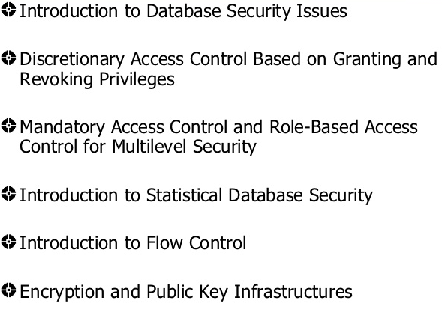
Database Security

Slide 5
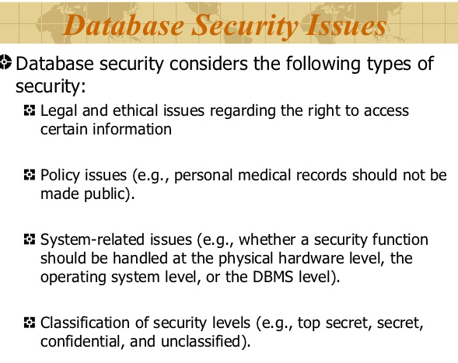
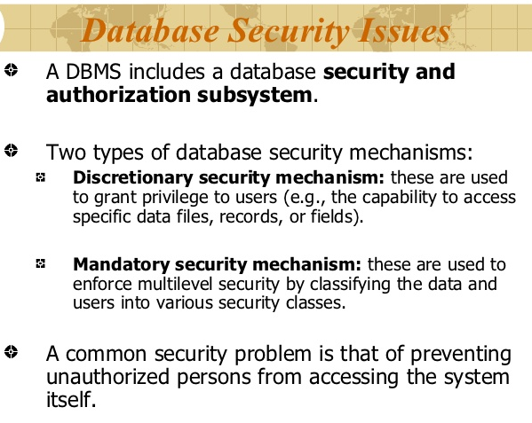
Database Security

Slide 6
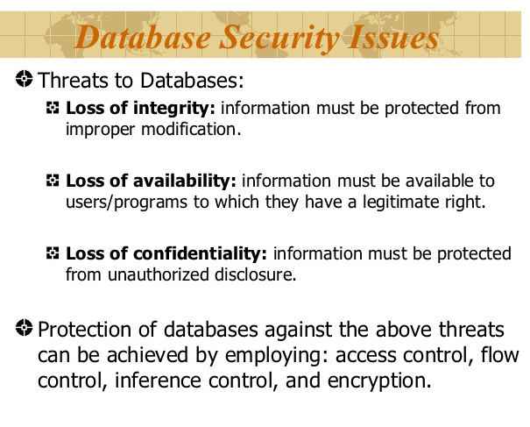
Database Security

Slide 7
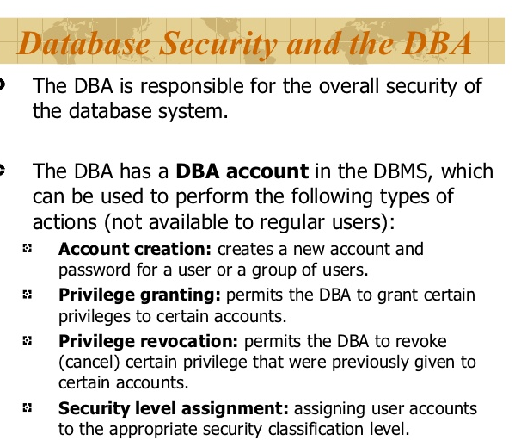
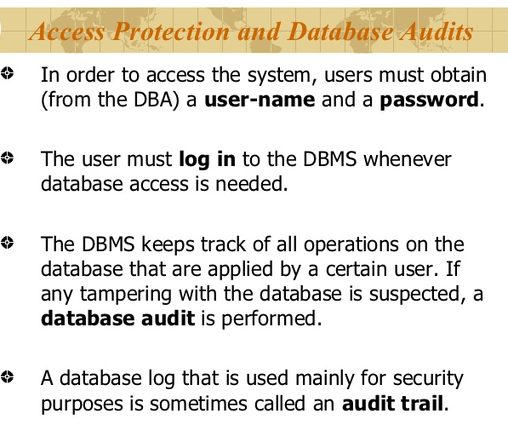
Database Security

Slide 8
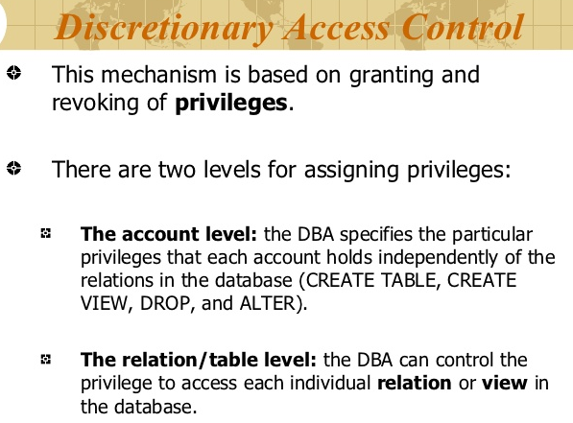
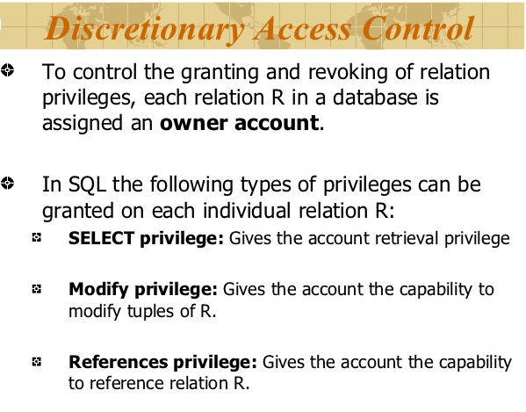
Database Security

Slide 9
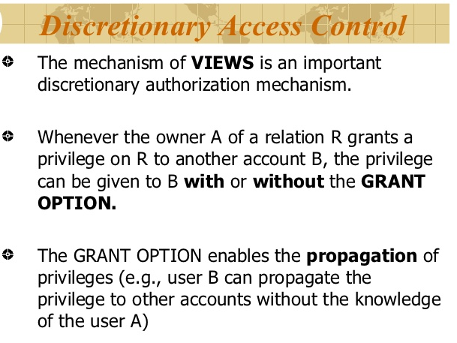
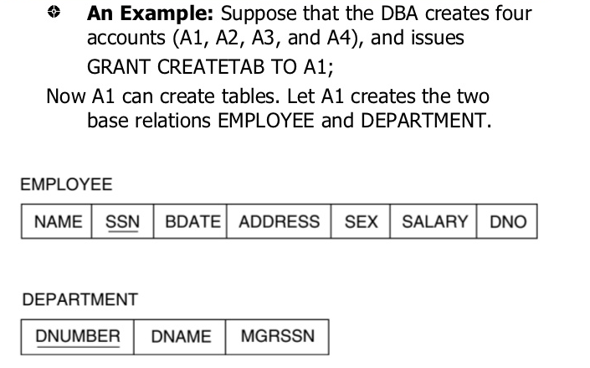
Database Security

Slide 10
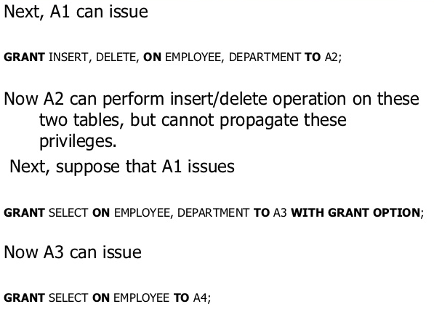
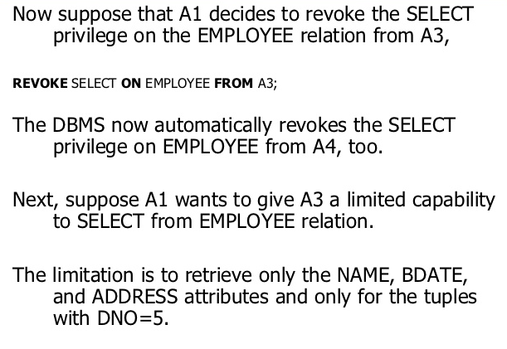
Database Security

Slide 11
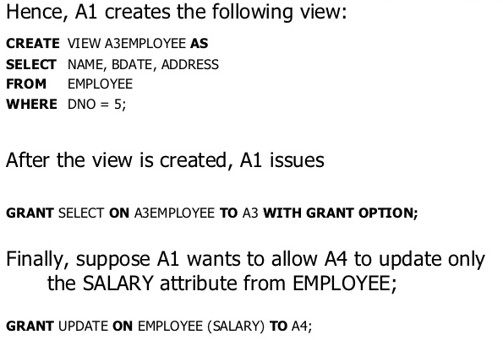
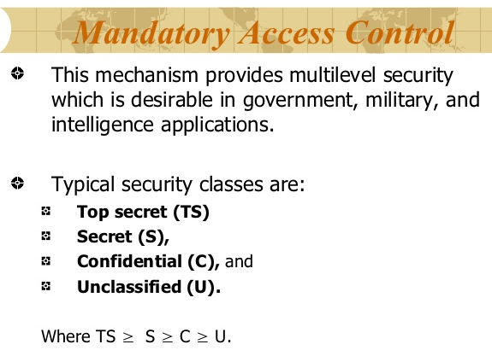
Database Security

Slide 12
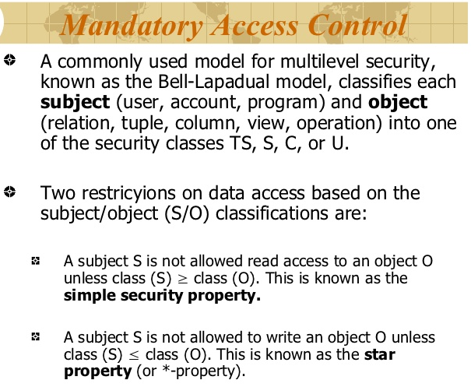
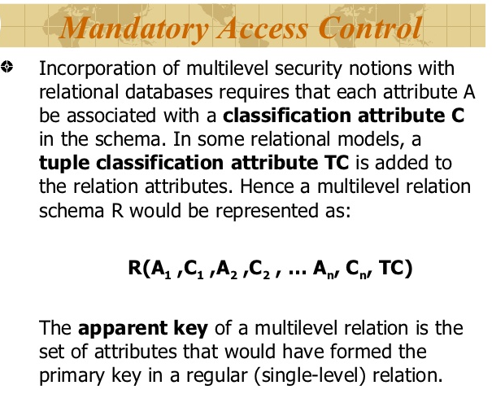
Database Security

Slide 13
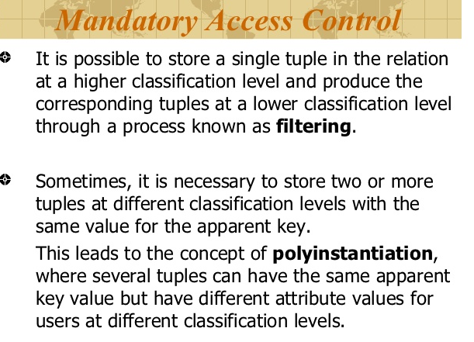
Database Security

Slide 14
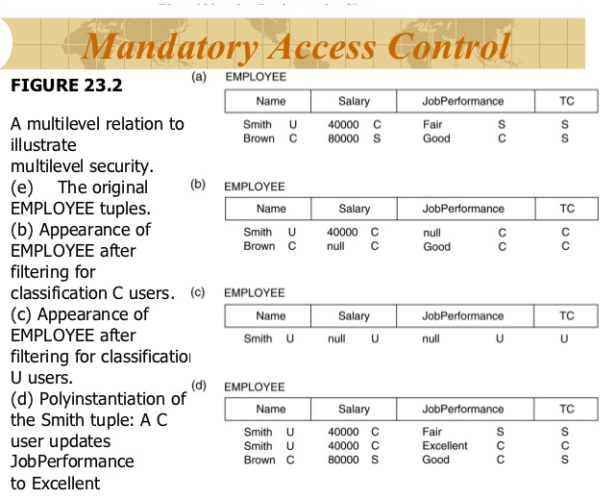
Database Security

Slide 15
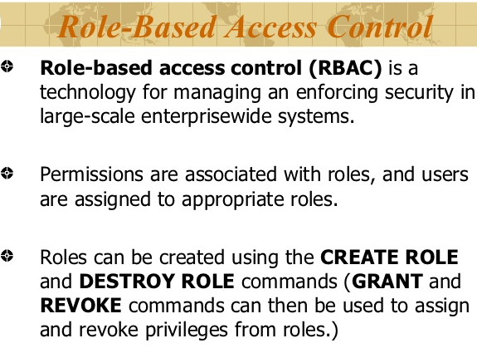
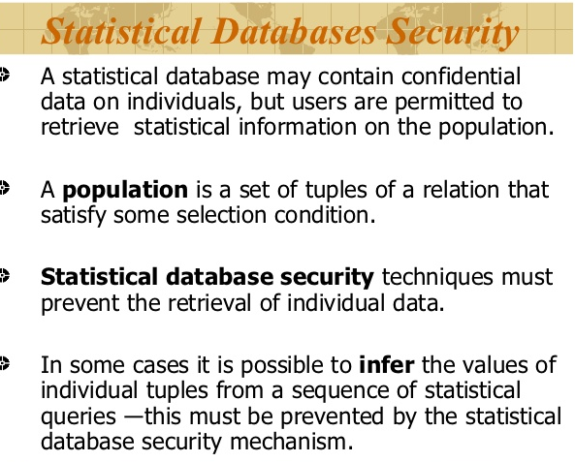
Database Security

Slide 16
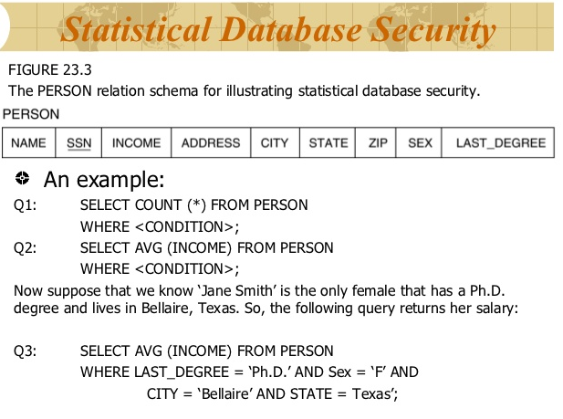
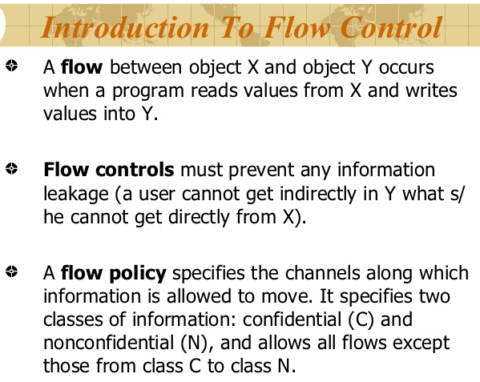
Database Security

Slide 17
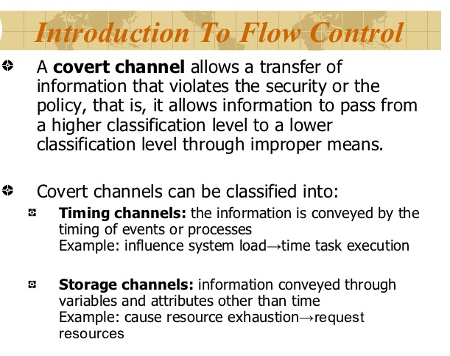
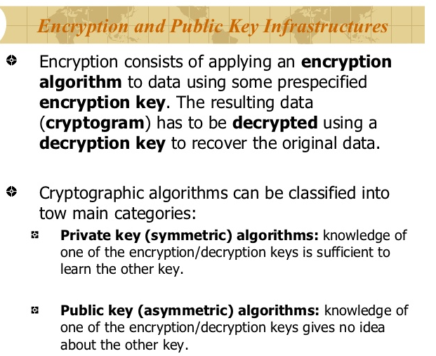
Database Security

Slide 18
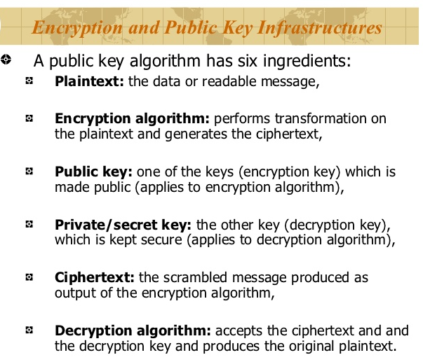
Database Security

Slide 19
Database Security
Database Security: Protection of the data against accidental or intentional loss, destruction, or misuse
Increased difficulty due to Internet access and client/server technologies

Slide 20
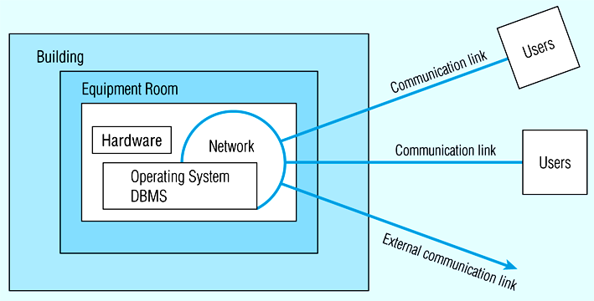
Figure 12-2: Possible locations of data security threats

Slide 21
Threats to Data Security
Accidental losses attributable to:
Human error
Software failure
Hardware failure
Theft and fraud.
Improper data access:
Loss of privacy (personal data)
Loss of confidentiality (corporate data)
Loss of data integrity
Loss of availability (through, e.g. sabotage)

Slide 22
Data Management Software Security Features
Views or subschemas
Integrity controls
Authorization rules
User-defined procedures
Encryption
Authentication schemes
Backup, journalizing, and checkpointing

Slide 23
Views and Integrity Controls
Views
Subset of the database that is presented to one or more users
User can be given access privilege to view without allowing access privilege to underlying tables
Integrity Controls
Protect data from unauthorized use
Domains – set allowable values
Assertions – enforce database conditions

Slide 24
Authorization Rules
Controls incorporated in the data management system
➔Restrict:
access to data
actions that people can take on data
➔Authorization matrix for:
Subjects
Objects
Actions
Constraints

Slide 25
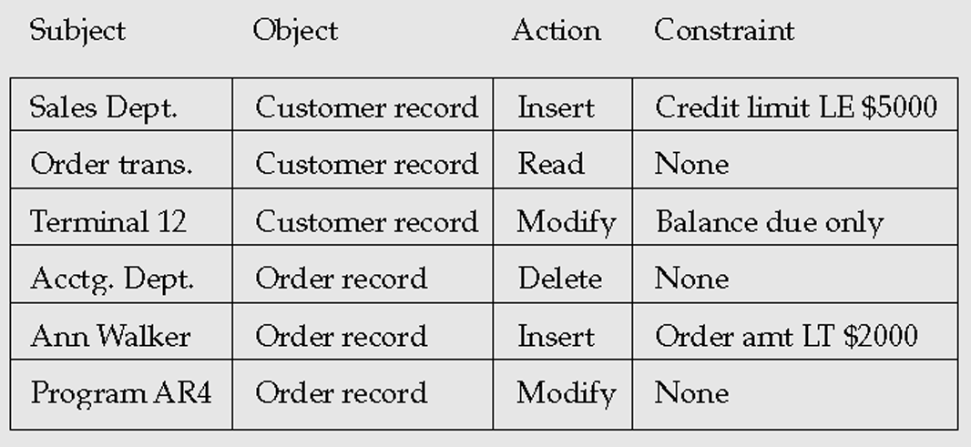
Figure 12-3: Authorization matrix

Slide 26
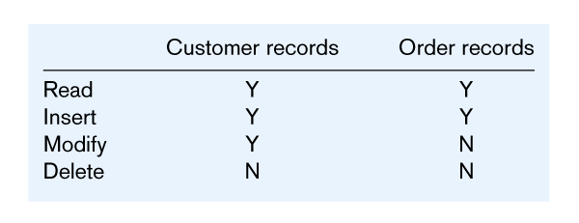

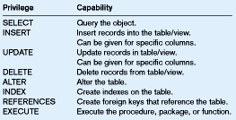
Figure 12-4(a): Authorization table for subjects
Figure 12-4(b): Authorization table for objects
Figure 12-5: Oracle8i privileges
Some DBMSs also provide capabilities for user-defined procedures to customize the authorization process

Slide 27
Authentication Schemes
Goal – obtain a positive identification of the user
Passwords are flawed:
Users share them with each other
They get written down, could be copied
Automatic logon scripts remove need to explicitly type them in
Unencrypted passwords travel the Internet
Possible solutions:
Biometric devices – use of fingerprints, retinal scans, etc. for positive ID
Third-party authentication – using secret keys, digital certificates

Slide 28
SQL Injection
SQL injection is a code injection technique that might destroy your database.
SQL injection is one of the most common web hacking techniques.
SQL injection is the placement of malicious code in SQL statements, via web page input.
SQL injection usually occurs when you ask a user for input, like their username/userid, and instead of a name/id, the user gives you an SQL statement that you will unknowingly run on your database.
Look at the following example which creates a SELECT statement by adding a variable (txtUserId) to a select string. The variable is fetched from user input (getRequestString):
txtUserId = getRequestString("UserId"); txtSQL = "SELECT * FROM Users WHERE UserId = " + txtUserId;

Slide 29
SQL Injection
SQL Injection Based on 1=1 is Always True
Look at the example above again. The original purpose of the code was to create an SQL statement to select a user, with a given user id.
If there is nothing to prevent a user from entering "wrong" input, the user can enter some "smart" input like this:
UserId: 105 OR 1=1
Then, the SQL statement will look like this:
SELECT * FROM Users WHERE UserId = 105 OR 1=1;
The SQL above is valid and will return ALL rows from the "Users" table, since OR 1=1 is always TRUE.

Slide 30
SQL Injection
Does the example above look dangerous? What if the "Users" table contains names and passwords?
The SQL statement above is much the same as this:
SELECT UserId, Name, Password FROM Users
WHERE UserId = 105 or 1=1;
A hacker might get access to all the user names and passwords in a database, by simply inserting 105 OR 1=1 into the input field.

Slide 31
SQL Injection Prevention
To protect a web site from SQL injection, you can use SQL parameters.
SQL parameters are values that are added to an SQL query at execution time, in a controlled manner.
Note that parameters are represented in the SQL statement by a @ marker.
The SQL engine checks each parameter to ensure that it is correct for its column and are treated literally, and not as part of the SQL to be executed.
txtNam = getRequestString("CustomerName"); txtAdd = getRequestString("Address"); txtCit = getRequestString("City"); txtSQL = "INSERT INTO Customers (CustomerName,Address,City) Values(@0,@1,@2)"; db.Execute(txtSQL,txtNam,txtAdd,txtCit);

Slide 32
SQL Injection prevention in PHP code
INSERT INTO STATEMENT IN PHP:
$stmt = $dbh->prepare("INSERT INTO Customers (CustomerName,Address,City) VALUES (:nam, :add, :cit)"); $stmt->bindParam(':nam', $txtNam); $stmt->bindParam(':add', $txtAdd); $stmt->bindParam(':cit', $txtCit); $stmt->execute();
Note: Having 4 or more level architecture can help us implement such SQLi Prevention.

Slide 33
THANK YOU

